Slide 1

Loops
TUIT
C++ Programming, Fall 2016
Lab #5
(I - part)

Slide 2
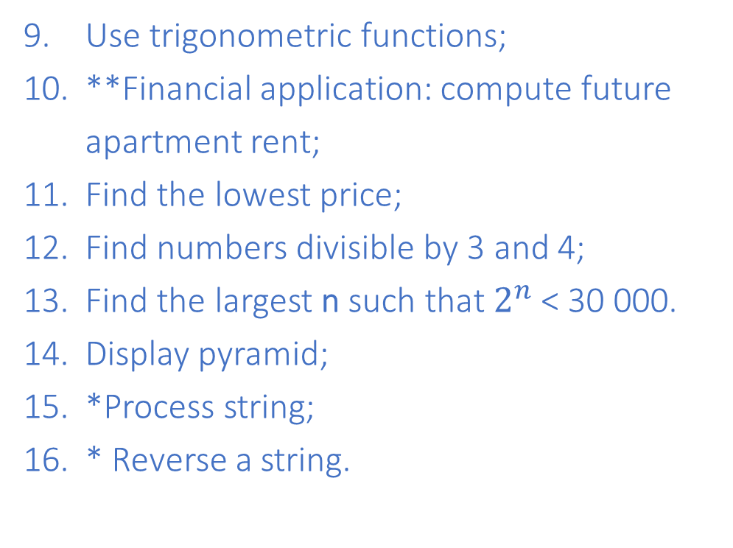
Read the lecture notes doing following tasks:
TUIT
Practice (I - part)
*Count p/n numbers and compute the average of numbers;
Count vowels and consonants;
Conversion from millimeters to inches;
Conversion from meters to feet;
*Product of a series;
**Sum, average and product of numbers in a file named numbers.txt;
*Financial application: compute CD value;
*Count uppercase letters;
Use trigonometric functions;
**Financial application: compute future apartment rent;
Find the lowest price;
Find numbers divisible by 3 and 4;
Find the largest n such that $2^{n}$ < 30 000.
Display pyramid;
*Process string;
* Reverse a string.

Slide 3
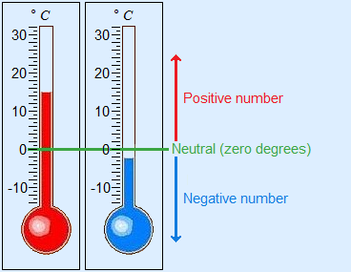


1. *Count p/n numbers and compute the average of numbers
TUIT
Write a program that reads an unspecified number of integers, determines how many positive and negative values have been read, and computes the total and average of the input values (not counting zeros). Your program ends with the input 0. Display the average as a floating-point number.
Here is a sample runs:
Enter an integer, the input ends if it is 0: 1 2 -1 3 0 The number of positives is 3 The number of negatives is 1 The total is 5 The average is 1.25
Enter an integer, the input ends if it is 0: 0 No numbers are entered except 0

Slide 4
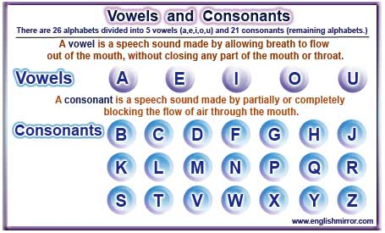
TUIT
2. *Count vowels and consonants
Assume a letters A, E, I, O, and U as the vowels. Write a program that prompts the user to enter a string and displays the number of vowels and consonants in the string.
Here is the sample run:
Enter a string: Programming is fun The number of vowels is 5 The number of consonants is 11

Slide 5
TUIT
3. Conversion from millimeters to inches
Write a program that displays the following table (note that 1 millimeter is 0.039 inches).
Here is the sample run:
Millimeters Inches 2 0.078 4 0.156 … 96 3.744 98 3.822

Slide 6
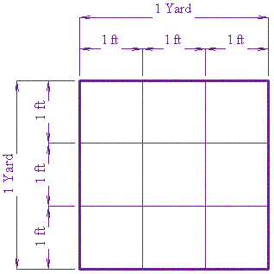
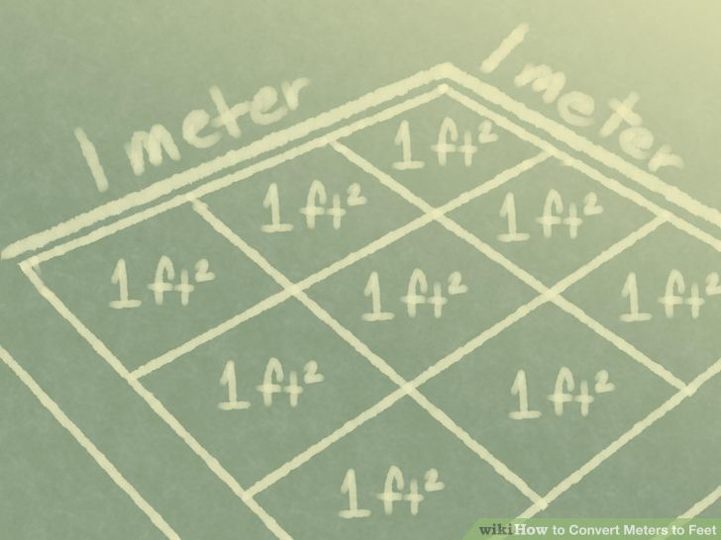
TUIT
4. Conversion from meters to feet
Write a program that displays the following table (note that 1 meter is 3.280 feet).
Here is the sample run:
Meters Feet 1 3.280 2 6.560 … 14 45.920 15 49.200

Slide 7
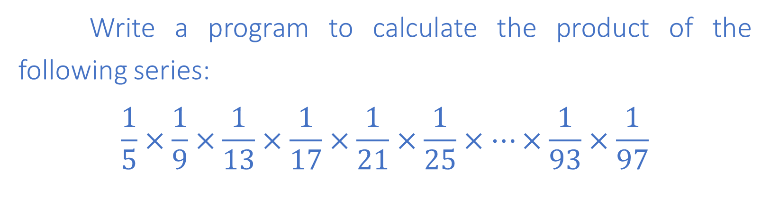
TUIT
5. *Product of a series
Write a program to calculate the product of the following series:
$$\frac{1}{5}×\frac{1}{9}×\frac{1}{13}×\frac{1}{17}×\frac{1}{21}×\frac{1}{25}×…×\frac{1}{93}×\frac{1}{97}$$

Slide 8
TUIT
6. **Sum , average and product of numbers
Write a program that calculates the sum, average and product of numbers in a file named numbers.txt

Slide 9
TUIT
7. *Financial application: compute CD value;
Suppose you put $10 000 into a CD with an annual percentage yield of 5.75%. After one month, the CD is worth 10000 + 10000 * 5.75 / 1200 = 10047.91
After the two months, the CD is worth 10047.91 + 10047.91 * 5.75 / 1200 = 10096.06
After the three months, the CD is worth 10096.06 + 10096.06 * 5.75 / 1200 = 10144.43 and so on. Write a program that prompts the user to enter an amount (e.g., 10000), the annual percentage yield (e.g., 5.75), and the number of months (e.g., 18) and displays a table as shown in the simple run.
Enter the initial deposit amount: 10000 Enter annual percentage yield: 5.75 Enter maturity period (number of months): 18 Month CD Value 10047.91 10096.06 … 10846.56 10898.54

Slide 10
TUIT
8. *Count uppercase letters
Write a program that prompts the user to enter a string and displays the number of the uppercase letters in the string.
Here is a sample run:
Enter a string: Programming Is Fun The number of uppercase letters is 3

Slide 11
TUIT
9. Use trigonometric functions
Print the following table to display the tan and cot values of degrees from 0 to 60 with increments of 10 degrees. Round the value to keep four digits after the decimal point.
Degree Sin/Cos Cos/Sin 10 0.0000 inf 20 0.1736 5.6713 … 50 1.1918 0.8391 60 1.7320 0.5774

Slide 12
TUIT
10. **Financial application: compute future apartment rent
Suppose that the rent for an apartment is &1000 this year and increases 3% every year. Write a program that computes the rent in five years and the total rent for one year starting five years from now.

Slide 13
TUIT
11. Find the lowest price
Write a program that prompts the user to enter the number of items and each item’s name and price, and finally displays the name and price of the item with the lowest price.
Here is the sample run:
Enter the number of items: 5 Enter the 1-item’s name and price: rice 12 Enter the 1-item’s name and price: sugar 15 Enter the 1-item’s name and price: oil 20 Enter the 1-item’s name and price: meat 23 Enter the 1-item’s name and price: egg 5 The lowest price item’s name is egg and price is $5.

Slide 14
TUIT
12. Find numbers divisible by 3 and 4
Write a program that displays all the numbers from 1 to 500. 5 per line, that are divisible by 3 and 4. Numbers are separated by exactly on space.
Here is the sample run:
These numbers are divisible by 3 and 4: 12 24 36 48 60 72 84 96 108 120 … 372 384 396 408 420 432 444 456 468 480 492

Slide 15
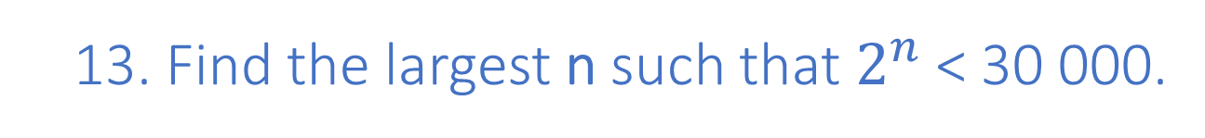
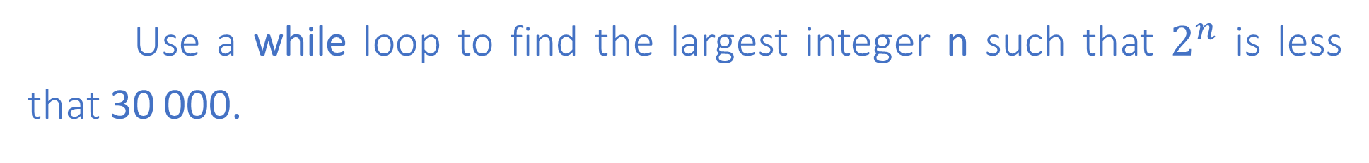
TUIT
13. Find the largest n such that $2^{n}$ < 30 000.
Use a while loop to find the largest integer n such that $2^{n}$ is less that 30 000.

Slide 16
TUIT
14. Display pyramid
Write a program that prompts the user to enter an integer from 1 to 15 and displays a pyramid, as shown in the following sample run:
Here is the sample run:
Enter the number of lines: 7 1 2 1 2 3 2 1 2 3 4 3 2 1 2 3 4 5 4 3 2 1 2 3 4 5 6 5 4 3 2 1 2 3 4 5 6 7 6 5 4 3 2 1 2 3 4 5 6 7

Slide 17
TUIT
15. *Process string
Write a program that prompts the user to enter a string and displays the characters at odd index positions.
Here is the sample run:
Enter a string: ABeijing Chicago BiigCiao

Slide 18
TUIT
16. * Reverse a string
Write a program that prompts the user to enter a string and displays the string in reverse order
Here is the sample run:
Enter a string: ABCD The reversed string is DCBA

